Slide 1
Student Forum
NML congress 2025 in Reykjavik

Slide 2
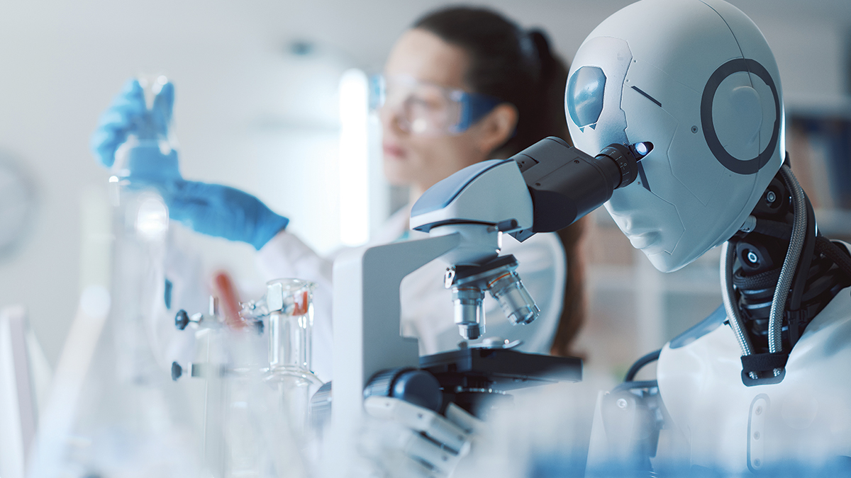
Student Forum Theme 2025 Artificial intelligence (AI) in biomedical laboratory science

Slide 3
Background
Artificial intelligence and machine learning have vastly become a transformative force in biomedical laboratory science among other fields
Examples of how AI is utilized in clinical laboratories
Pathology – analysis of histopathology images for detection of cancers, infections or abnormalities
Hematology – analysis of blood smears, identification of cell types and flagging abnormalities (anemia, leukemia)
Molecular diagnostics – identification of genetic mutations and biomarkers
Microbiology – identification of microbial growth patterns and antibiotic resistance

Slide 4
Research
The current and future role of AI in laboratory science
How AI is being used in laboratory diagnostics in your country?
Interview a lab manager or someone involved in AI at a clinical laboratory of your choice
What does the future behold in AI?
Interview an employee of an innovative company in your country focusing on AI in health science

Slide 5
Example of questions for interview Laboratory part
What types of AI-driven technologies or systems are currently in use in your lab?
How has AI influenced the operations and efficiency of your laboratory?
What are the biggest challenges you face when integrating AI into diagnostic and automation workflow?
How do you stay updated on the latest developments in AI for diagnostics and automation?
What areas of diagnostics or automation do you think AI will revolutionize further in the next years?
These are just examples of questions, base this interview on your interests and what you believe is relevant.

Slide 6
Example of questions for interview Innovation part
What is the current primary mission of your company regarding AI in health science?
What specific challenges in health science are you addressing with your AI solutions?
How do you address ethical concerns, such as bias in AI models or the potential for over-reliance on automation?
How do you tackle skepticism or resistance from healthcare professionals or institutions regarding the adoption of AI?
How do you visualize the future when it comes to AI in health science?
Reasonable scenarios?
Wildest dreams possible?
These are just examples of questions, base this interview on your interests and what you believe is relevant.

Slide 7
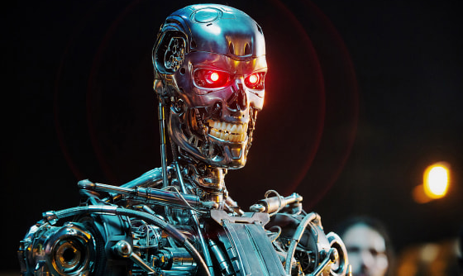
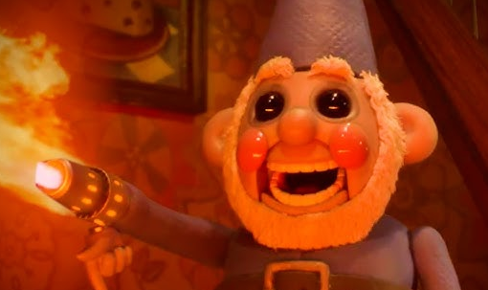
Thoughts
In 2023 scientist reported the use of novel voice biomarkers for the detection of disease using artificial intelligence and machine learning
See article in attached pdf
What are your thoughts of this innovative method as a diagnostic tool?
Could this method replace traditional diagnostic like blood analysis?
In what fields can we as biomedical scientists be replaced by AI?
Is it safe to let go and trust AI for certain tasks or do we always need a human input for confirmation?
For what tasks do we need to be extra careful when adopting to AI utilization?
Why are we implemented to be so afraid of changes and technology even at an early age?

Slide 8
Findings
Present your findings for the other students in a format of your choice (oral presentation, power point presentation, video etc)
Afterwards we will discuss your findings and produce a plan for your joined presentation
Presented at the final day of congress

Slide 9
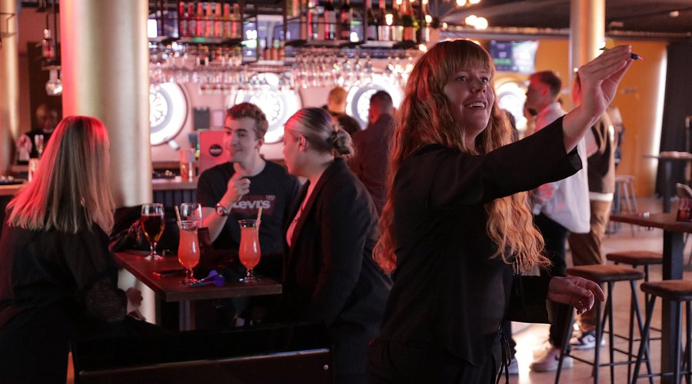
Social activity 5th of May
After the welcome reception at Hilton we will walk to Bullseye on Snorrabraut for a chance to play darts, have drinks and get to know each other
It will only be a 15-minute walk from Hilton hopefully in a lovely spring weather
If not, we can take either a bus or taxis

Slide 10
See you in Reykjavik
We are looking forward to seeing you this May for the NML congress
If you have any questions or thoughts, you are welcome to contact us
(Erla Bragadóttir and Katrín Birna Pétursdóttir)
erlabrag@landspitali.is
katrinbp@landspitali.is

